Slide 1
Simulation and Optimization of the transfer of thin flexible sheet metal parts in transfer presses
Josef Prinz
Math for the Digital Factory
May 7-9, 2014

Slide 2
Content
Overview of the problem domain (Videopresentation)
Planning Task
Constraints for the planning and optimization
Methods, Models and Algorithms
Summary and Conclusion

Slide 3
Content
Overview
1
2
3
4
5
6
7
8
9
Overview of the problem domain
Planning Task
Constraints for the planning and optimization
Methods, Models and Algorithms
Summary and Conclusion

Slide 4
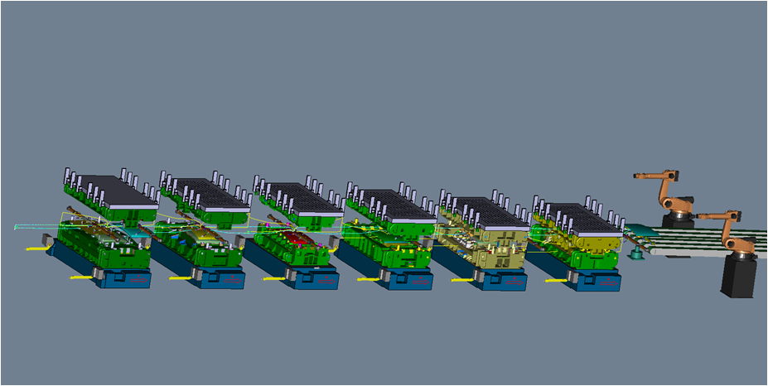
Problem Domain
Overview
1
2
3
4
5
6
7
8
9
Metal-forming presses
newer, higher-strength steels, demands attention to press design and methods of press motion
Servo-driven presses
control the stamping press stroke length and velocity
dwell time at the bottom of a press stroke, where forming work occurs
individual setup for each part
Transfer-presses
Crossbar feeder between stations
Phase offset between stations
Synchronization of stroke (die) motion and feeder motion
individual setup for each part
3D-model of a transfer-press
Phase1
Phase 2
Phase 3
Phase 4
Feeder1
Feeder2
Feeder3
Station 1
Station 2
Station 3
Station 4
phase offset between stations

Slide 5
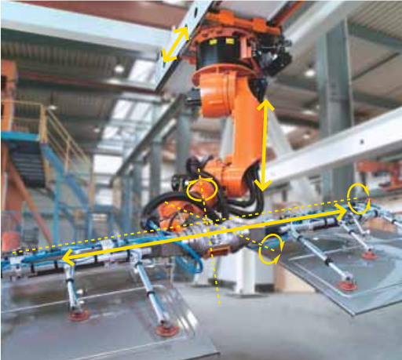
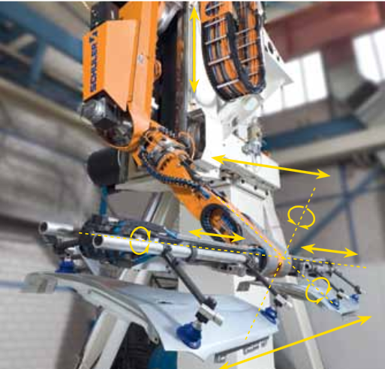
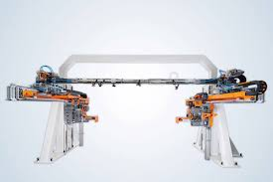
Feeder Systems, Industry Examples
Crossbar Robot
Crossbar Feeder
Compact Transfer
Crossbar

Slide 6
Videopresentation recorded from PressLineSimulation, Siemens PLM Software
Overview
1
2
3
4
5
6
7
8
9

Slide 7
Content
Overview
1
2
3
4
5
6
7
8
9
Overview of the problem domain
Planning Task
Constraints for the planning and optimization
Methods, Models and Algorithms
Summary and Conclusion

Slide 8
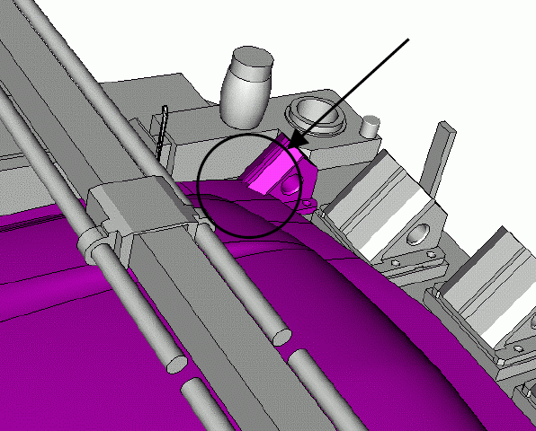
Planning the Transfer
Overview
1
2
3
4
5
6
7
8
9
Collision free transfer
Prerequisites
3d model of the press, the tooling and the sheet metal parts
kinematic models with dynamics
simulation system
Workflow
configuration of the simulation
run the simulation
analyze the detected collisions
change the design
Part of the feeder
Collision with lower die
Metal part

Slide 9
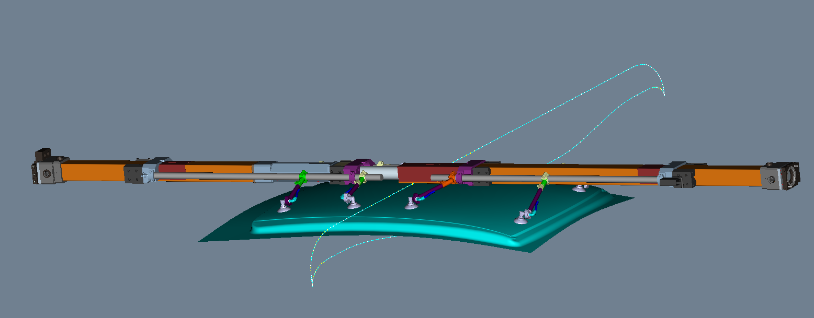
Planning the Transfer
Overview
1
2
3
4
5
6
7
8
9
Path planning
Determination of pick and place coordinates
Motion with part attached
Motion with no part attached
Curve design
Adaption of predefined paths
Feasibility Study
Drive properties
Simulation
Curve Optimization
Change dynamics (velocity)
Change coordinates
feeder and its motion path
Overload of a drive at
these positions
feasibility study for a curve segment

Slide 10
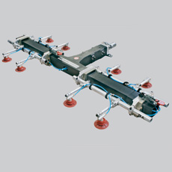
Planning the Transfer
Overview
1
2
3
4
5
6
7
8
9
Tooling Design
Selection, configuration
Part handling
Specification of the holding positions
Feasibility Study
Ranges of contact pressure
Consideration of motion dynamics
Simulation
tooling system
positions for vacuum cups

Slide 11
Content
Overview
1
2
3
4
5
6
7
8
9
Overview of the problem domain
Planning Task
Constraints for the planning and optimization
Methods, Models and Algorithms
Summary and Conclusion

Slide 12
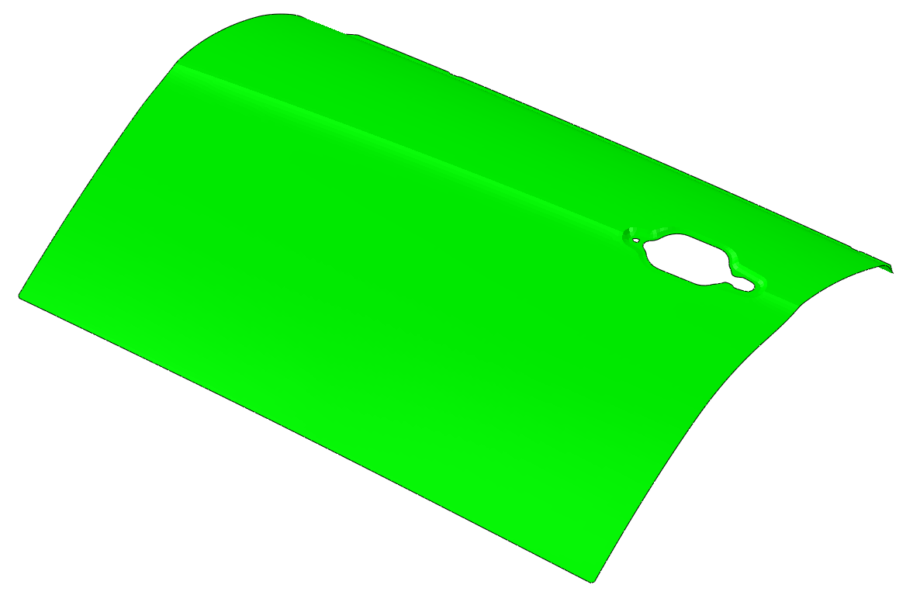
Objectives
Overview
1
2
3
4
5
6
7
8
9
Metal-Part
No damage
due to plastic deformation
due to collisions
due to process failures (loss of contact)
Minimal risk
minimal vibration
Production
High output rate
maximal velocity
High efficiency
low energy consumption
m
F
a
F
forces and change of motion
deformation in a time step

Slide 13
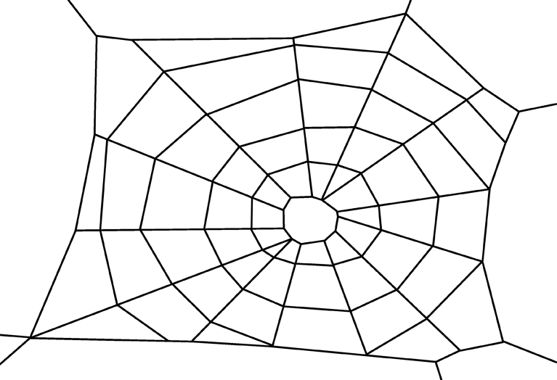
Support
Overview
1
2
3
4
5
6
7
8
9
Planning
provide maximum process reliability
realistic behavior
short response time
Operation
fast, automatic setup (controller configuration)
individually optimized
Performance
Reliability
Efficiency
Quality
Workflow Automation
Quantity

Slide 14
Content
Overview
1
2
3
4
5
6
7
8
9
Overview of the problem domain
Planning Task
Constraints for the planning and optimization
Methods, Models and Algorithms
Summary and Conclusion

Slide 15
Main Methods
Overview
1
2
3
4
5
6
7
8
9
Path planning
Dependencies
drive properties
feeder kinematics
geometry
Result
feasible motion path
Deformation calculation
Dependencies
part properties
applied forces
Result
realistic vibration amplitudes
collisions
collision detection
path planning
deformation along a path
motion path
deformation calculation

Slide 16
Main Methods
Overview
1
2
3
4
5
6
7
8
9
Collision detection
Dependencies
volume of oscillating part in motion
interference with other press-motions
interference with other press-geometries
Result
detection of relevant collisions
collisions
collision detection
path planning
deformation along a path
motion path
deformation calculation

Slide 17
Additional Methods
Overview
1
2
3
4
5
6
7
8
9
Tooling optimization
Dependencies
part properties
tooling properties
motion dynamics
Result
Optimal amount of holders
Optimal holder positions
collisions
collision detection
path planning
deformation along a path
motion path
Tooling optimization
deformation calculation
holding positions

Slide 18
Additional Methods
Overview
1
2
3
4
5
6
7
8
9
(Transfer-) Speed Optimization
Dependencies
press-stroke length and velocity
“many” constraints (everything, considered before)
Result
maximum velocity of feeder system
collisions
collision detection
path planning
deformation along a path
motion path
Tooling optimization
deformation calculation
stroking path
speed optimization
holding positions

Slide 19
Additional Methods
Overview
1
2
3
4
5
6
7
8
9
Energy Optimization
Dependencies
mass moment of inertia depend on drive types
Result
adjusted motion dynamics with only “accepted” time delays for lowest energy consumption
collisions
collision detection
path planning
deformation along a path
motion path
Tooling optimization
deformation calculation
stroking path
speed optimization
holding positions
moved mass
energy optimization

Slide 20
Additional Methods
Overview
1
2
3
4
5
6
7
8
9
Path Planning
Place Operation
Determination of the optimal time to release the part (dropped on the die)
Forming result depends on part deformation an part position after dropping
Pick Operation
no vibration free lift up position, due to
springback after forming
high speed
Stabilizers (part of the upper die) should guarantee a secure lift up
collisions
pick
collision detection
path planning
place
deformation along a path
motion path
Tooling optimization
deformation calculation
stroking path
speed optimization
holding positions
moved mass
energy optimization

Slide 21
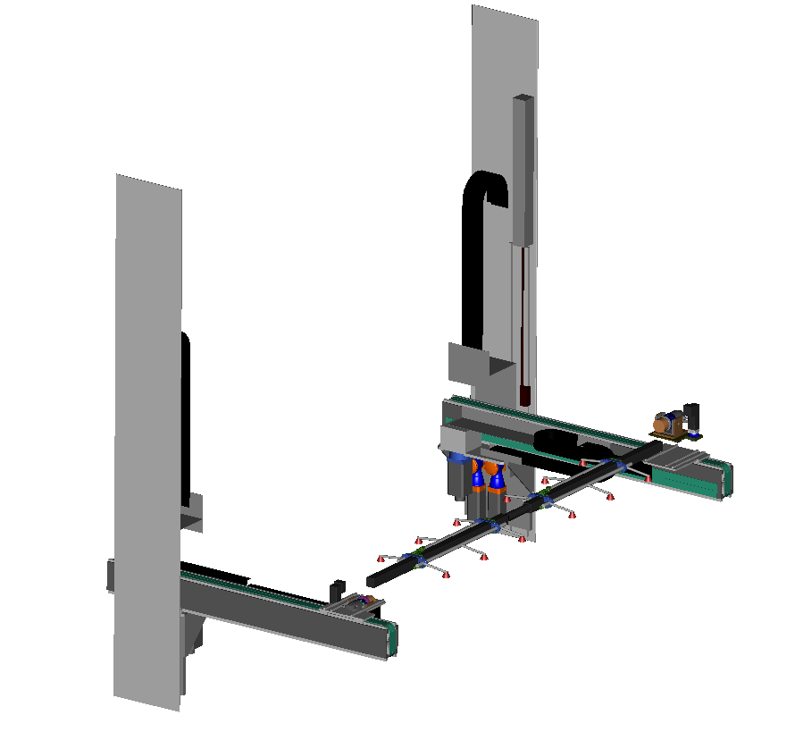
Path planning “algorithm”
Overview
1
2
3
4
5
6
7
8
9
Model
Kinematics Model
8 machine axes (DOF)
definition of articulated system (active joints, passive joints)
tooling coordinates
Drive Characteristics
maximal torque
this is often a black box
F
U2
machine axes
YL
W
BL
YR
Z
B
BR
C
Y
U1
X
A
Feeder system

Slide 22
Path planning “algorithm”
Overview
1
2
3
4
5
6
7
8
9
Algorithm
Input
proprietary standard paths as start solutions
definition of “path segments” (with a significant curve progression)
interactive modification of single curve points
Calculation
calculation of modified segment (curve progression) by proprietary software (provided by the supplier of the feeder system with build in knowledge about drive properties)
s₇
s₆
s₅
x
s₄
s₀
s₁
s₃
s₂
segmented path
s₇
s₆
s₅
s₄
s₀
s₁
s₃
s₂
segmented path - segment modification

Slide 23
Path planning “algorithm”
Overview
1
2
3
4
5
6
7
8
9
Future algorithm modifications
Input
generation of feasible start solutions with given pick and place positions considering the geometric situation and drive characteristics
Automatic optimization
automatic segmentation
selection of “sensitive” segments
variation of curve coordinates
automatic verification
metal part follows the movement of the crossbar

Slide 24
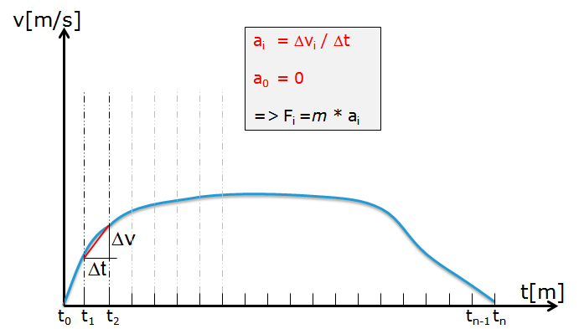
Deformation calculation “algorithm”
Overview
1
2
3
4
5
6
7
8
9
Model (FE-Model)
Forces
gravitational force
deceleration forces
equidistant time steps
linear path approximation in time intervals
clamping forces
aerodynamic drag forces
deceleration model
n=360

Slide 25
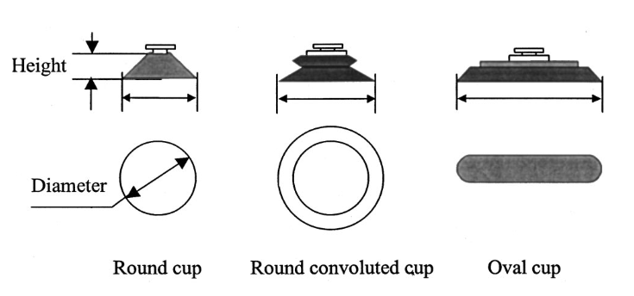
Deformation calculation “algorithm”
Overview
1
2
3
4
5
6
7
8
9
Model (FE-Model)
Forces
gravitational force
deceleration forces
clamping forces
damped spring - mass model
size of the cup to part contact region depends on cup size and on the vacuum pressure level (mesh resolution and cup diameter need adjustment)
spring stiffness in the model depends on cup stiffness (most critical parameter [0,5 N/mm, 50 N/mm], determination from recording the loading and the cup extension or contraction)
aerodynamic drag forces
cup parameters
Cup to part contact region
clamping forces model

Slide 26
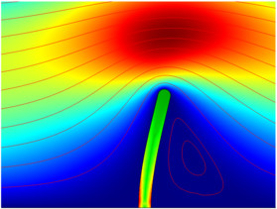
Deformation calculation “algorithm”
Overview
1
2
3
4
5
6
7
8
9
Model (FE-Model)
Forces
gravitational force
deceleration forces
clamping forces
aerodynamic drag forces
relevance depends on part size and velocity
structural mechanics and fluid-structure interaction
no aerodynamic fluid model for press-station
Picture from Comsol model galery

Slide 27
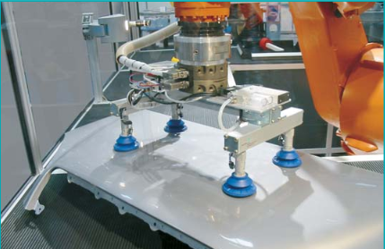
Deformation calculation “algorithm”
Overview
1
2
3
4
5
6
7
8
9
Model (FE-Model)
Forces
gravitational force
deceleration forces
clamping forces
aerodynamic drag forces
Vibration characteristics
Metal part
oscillation depends on elasticity and mass
Clamping
forces and elasticity
Suction cups with folds are adaptable to the lift height and unevenness of surface

Slide 28
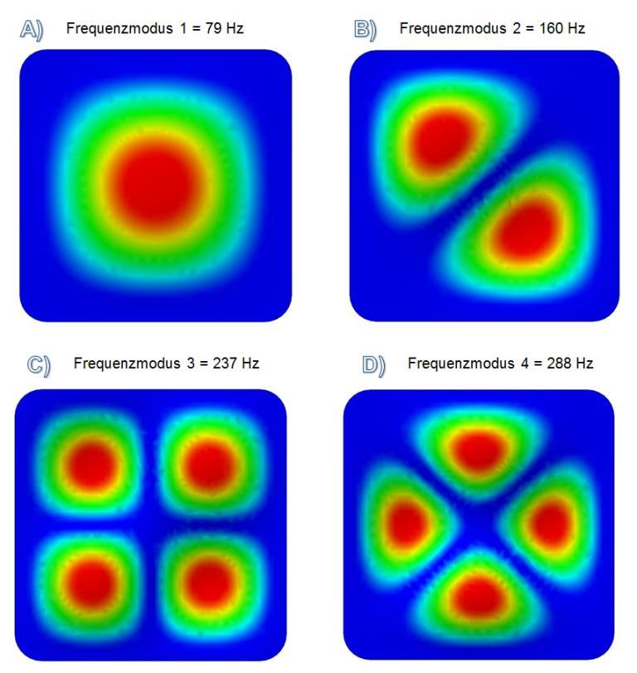
Deformation calculation “algorithm”
Overview
1
2
3
4
5
6
7
8
9
Algorithm
Preprocessing
numerical modal analysis (eigenmodes)
Simulation (linear elastic)
static simulation (linear perturbation analysis), deformation under time-dependent load
dynamic Simulation, deformation under time-dependent load with consideration of oscillations by mass inertia
part is not moved, but the time-varying force is applied
Postprocessing
deformation volume calculation
As a maximal volume (sufficient precision)
Or as a swept volume
numerical modal analysis to get eigenmodes (metal part without beads)
Clamping forces (dynamic , static )

Slide 29
DPP-18 Datendefinitionen
Bewegungsbahn
v[m/s]
a_{i} = Δv_{i} / Δt
a₀ = 0
=> F_{i} =m * a_{i}
Δv
Δt
t[m]
t₀
t₁
t₂
t_{n-1}
t_{n}

Slide 30
DPP-18 Datendefinitionen
v[m/s]
t[m]

Slide 31
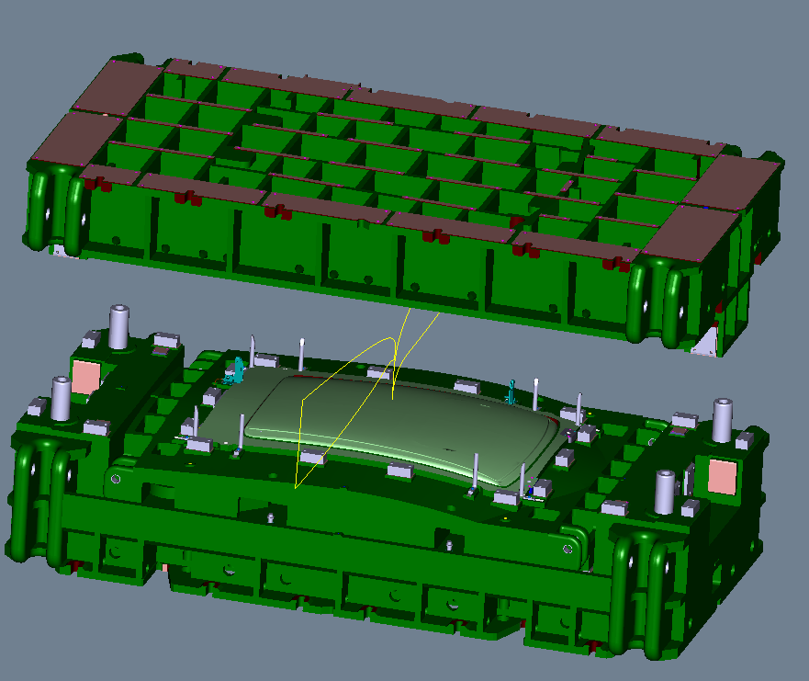
Collision detection algorithm
Overview
1
2
3
4
5
6
7
8
9
Models
CAD-Model of the Press and the components
Volume Model of the vibrating part (maximal volume)
Identification of collision relevant objects (allowed approximation or unwanted interaction)
Algorithm
continuous (bodies in motion)
discreet (bodies at one time)
CAD models of a roof and the forming dies
Volume of the vibrating part

Slide 32
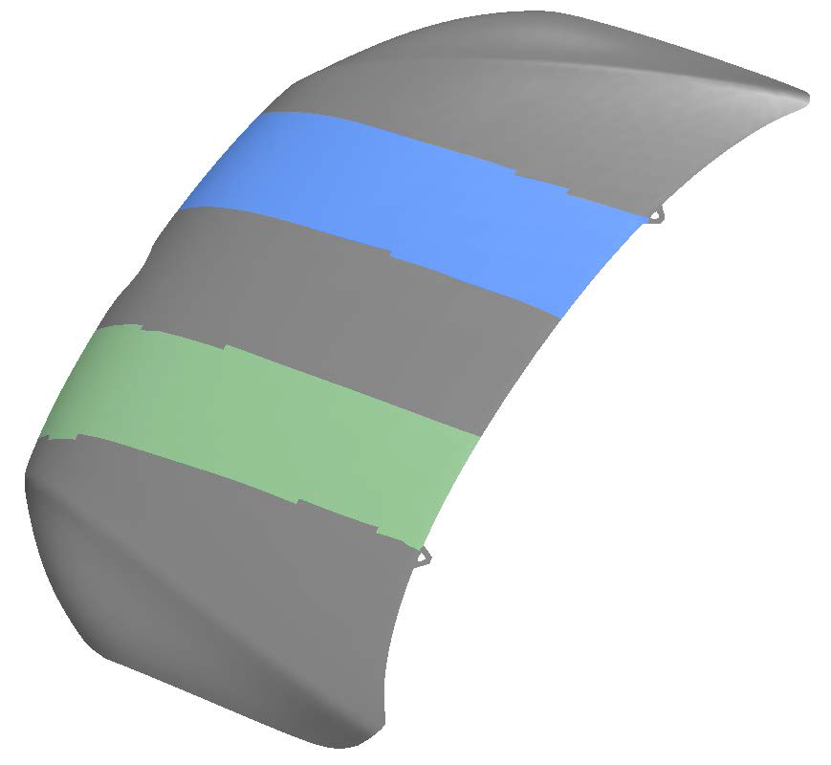
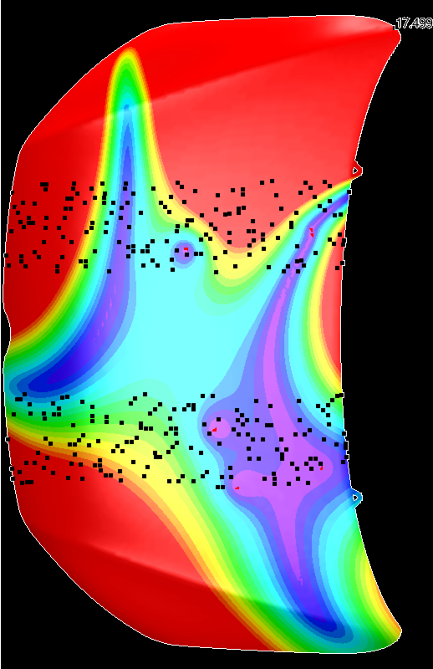
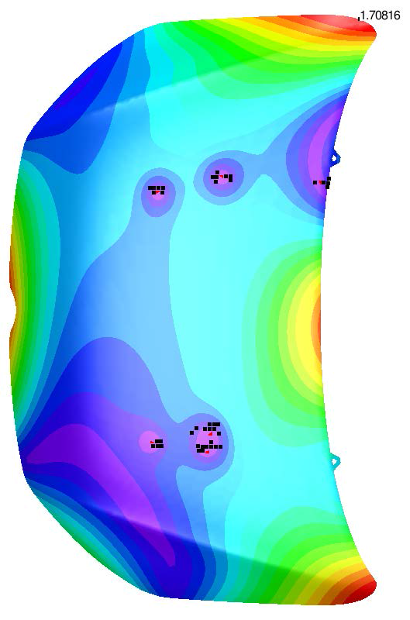
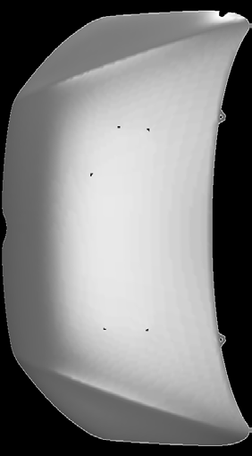
Tooling optimization
Overview
1
2
3
4
5
6
7
8
9
Objectives
Variants
Number of cups
cup Position
Cup Properties (stiffness, diameter, height)
Minimal Oscillation
Algorithm
Evolutionary Computation
Definition of feasible start positions or exploratory areas
Exploration of the defined areas with a genetic algorithm
Mathematical Optimization problem
Deformation contour definition
N – Simulations with different parameters
Optimization study from Volkswagen GmbH
Formalization of the optimization Problem

Slide 33
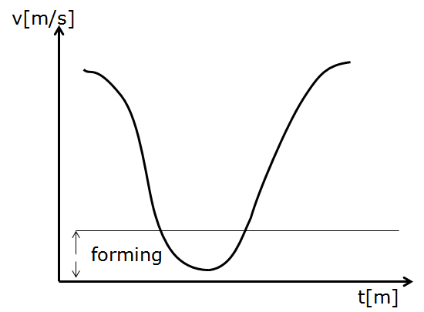
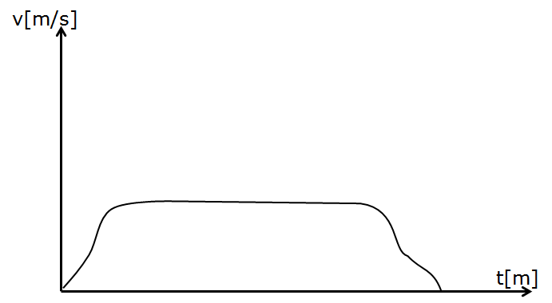
Speed optimization
Overview
1
2
3
4
5
6
7
8
9
Targets
Maximal number of strokes per minute
Algorithm
Find the optimal curve for Press-Stroke and Transfer
Stroke - curve
Forming quality
Transfer – curve
Transfer quality
Coupled Optimization Algorithm
Collision detection, Deformation calculation, Tooling Optimization, …
Stroke - Curve
Transfer - Curve

Slide 34
DPP-18 Datendefinitionen
v[m/s]
forming
t[m]

Slide 35
Content
Overview
1
2
3
4
5
6
7
8
9
Overview of the problem domain
Planning Task
Constraints for the planning and optimization
Methods, Models and Algorithms
Summary and Conclusion

Slide 36
Summary and Conclusion
Overview
1
2
3
4
5
6
7
8
9
Higher complexity in process planning due to new machine technology (servo-driven presses) and part properties (thin, elastic sheet metal parts)
Evaluation of complex causes and effect relationships necessary
Integration of Simulation-, Calculation- and Optimization - Methods required
fast Calculation Algorithms
sufficient realistic Models
automatic (user assisted) Optimization
More transparency of “Existing black boxes” is needed
Kinematic behavior
Drive characteristic
Tooling characteristic
Cooperative work of Operator, Manufacturer, Software supplier and Research institution

Slide 37
Acknowledgements
Siemens PLM Software and their contribution of the simulation software PressLine-Simulation
Volkswagen AG, Digital die design
inpro, Process Simulation

Slide 38
Thank you for your attention
Do you have any questions?
M: josef.prinz@inpro.de

