Slide 1



Factories of the Future PPP
Achievements and FoF 2020
7 May 2014
Rikardo Bueno
Co-chair of the FoF Partnership Board

Slide 2


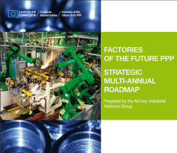


The Factories of the Future PPP
Over € 1 Billion total project budget
151 Projects launched
Over 1,000 organisations
50% industry participation
SME participation
Over € 2 Billion total project budget
Demonstration
Dissemination
Committed industry &
strong research network
Notes:
Re-cap on developments & achievements (as mentioned in plenary two)

Slide 3
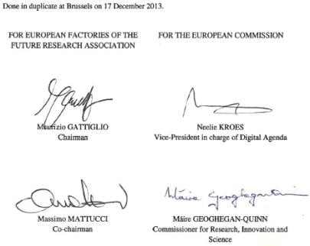
FoF-PPP & EFFRA in Horizon 2020 Contractual Agreement
Signed on behalf of EU by the European Commission & on behalf of private side by EFFRA
Budget secured by official legal act (Commission decision) and by signed Contractual Arrangement
Clearly defines roles of partners
Sets out specific objectives
Formal recognition of EFFRA’s role as representative of private side
Establishes Partnership Board
Agreement to better monitor progress, also with the use of KPIs

Slide 4


The FoF 2020 Roadmap
Notes:
Components of FoF 2020
The six R&I priority domains – heart of FoF 2020 roadmap

Slide 5
The FoF 2020 Roadmap
Notes:
Components of FoF 2020
The six R&I priority domains – heart of FoF 2020 roadmap

Slide 6




The FoF 2020 Roadmap
The FoF PPP: A cross-technology programme
Example: Photonics technologies enabling Manufacturing
The FoF 2020 Roadmap
Quality Control of Aluminium Laser-welded Assemblies
Additive Manufacturing for Wear and Corrosion Applications
Notes:
Components of FoF 2020
The six R&I priority domains – heart of FoF 2020 roadmap

Slide 7

The FoF 2020 Roadmap
The FoF PPP: A cross-technology programme
Example: Photonics technologies enabling Manufacturing
Femtosecond Laser Printer for Glass Microsystems with Nanoscale Features
Notes:
Components of FoF 2020
The six R&I priority domains – heart of FoF 2020 roadmap

Slide 8

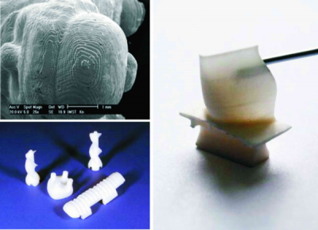
The FoF 2020 Roadmap
The FoF PPP: A cross-technology programme
Example: Photonics technologies enabling Manufacturing
Photopolymer based customized additive manufacturing technologies
Notes:
Components of FoF 2020
The six R&I priority domains – heart of FoF 2020 roadmap

Slide 9


The FoF 2020 Roadmap
The FoF PPP: A cross-technology programme
Development of adaptive ProductioN systems for Eco-efficient firing processes
Notes:
Components of FoF 2020
The six R&I priority domains – heart of FoF 2020 roadmap

Slide 10
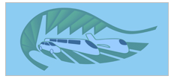
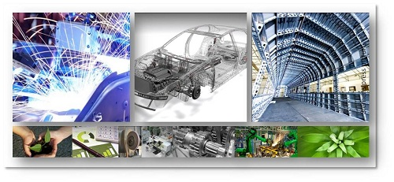
The FoF 2020 Roadmap
The FoF PPP: A cross-technology programme
EMC2-Factory
Eco Manufactured transportation means from Clean and Competitive Factory
Notes:
Components of FoF 2020
The six R&I priority domains – heart of FoF 2020 roadmap

Slide 11

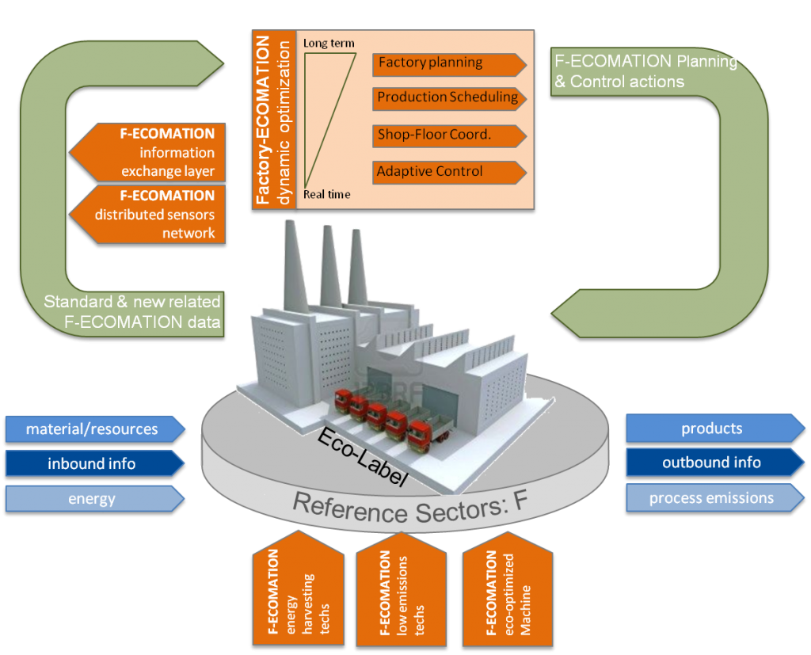
The FoF 2020 Roadmap
The FoF PPP: A cross-technology programme
Factory ECO-friendly and energy efficient technologies and adaptive autoMATION solutions
Notes:
Components of FoF 2020
The six R&I priority domains – heart of FoF 2020 roadmap

Slide 12


The FoF 2020 Roadmap
The FoF PPP: A cross-technology programme
Plug-and-produce COmponents and METhods for adaptive control of industrial robots enabling cost effective, high precision manufacturing in factories of the future
Plug and Produce Components for Optimum Dynamic Performance Manufacturing Systems
Notes:
Components of FoF 2020
The six R&I priority domains – heart of FoF 2020 roadmap

Slide 13


The FoF 2020 Roadmap
The FoF PPP: A cross-technology programme
Knowledge, Awareness and Prediction of Man, Machine, Material and Method in Manufacturing
Production Logistics and Sustainability Cockpit
Notes:
Components of FoF 2020
The six R&I priority domains – heart of FoF 2020 roadmap

Slide 14


The FoF 2020 Roadmap
The FoF PPP: A cross-technology programme
Innovative End-to-end Management of Dynamic Manufacturing Networks
Collaborative Manufacturing Network for Competitive Advantage
Notes:
Components of FoF 2020
The six R&I priority domains – heart of FoF 2020 roadmap

Slide 15
The FoF 2020 Roadmap
The FoF PPP: A cross-technology programme
MAN-MADE
MANufacturing through ergonoMic and safe Anthropocentric aDaptive workplacEs for context aware factories in EUROPE
Workplaces of the future: the new people-centred production site
Notes:
Components of FoF 2020
The six R&I priority domains – heart of FoF 2020 roadmap

Slide 16

The FoF 2020 Roadmap
The FoF PPP: A cross-technology programme
KNOW4CAR
  An Internet-based Collaborative Platform for Managing Manufacturing Knowledge
Notes:
Components of FoF 2020
The six R&I priority domains – heart of FoF 2020 roadmap

Slide 17

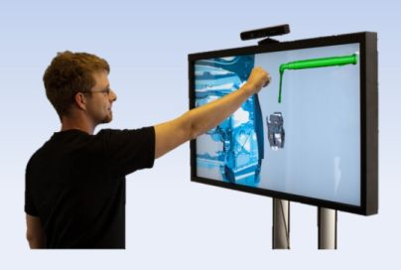
The FoF 2020 Roadmap
The FoF PPP: A cross-technology programme
Virtual Simulation and Training of Assembly and Service Processes in Digital Factories
Notes:
Components of FoF 2020
The six R&I priority domains – heart of FoF 2020 roadmap

Slide 18

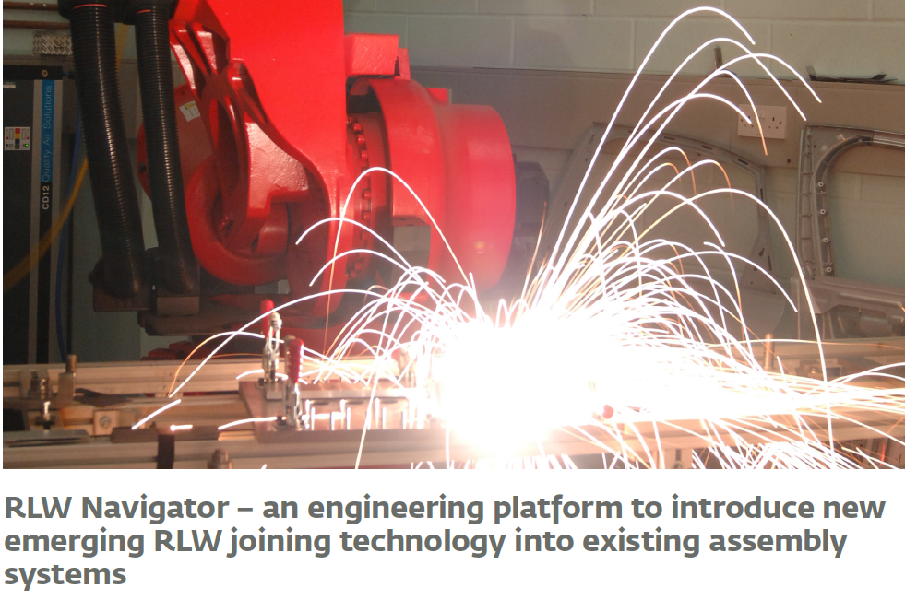
The FoF 2020 Roadmap
The FoF PPP: A cross-technology programme
Remote Laser Welding System Navigator for Eco & Resilient Automotive Factories
Notes:
Components of FoF 2020
The six R&I priority domains – heart of FoF 2020 roadmap

Slide 19

The FoF 2020 Roadmap
Manufacturing Future Products
Mobility
Healthcare (from clothing to medical equipment)
Energy systems (solar, wind and tidal power solutions and energy storage)
Smart systems (including embedded systems and micro-mechanical systems or systems with nano-features)
….
Notes:
Components of FoF 2020
The six R&I priority domains – heart of FoF 2020 roadmap

Slide 20


The FoF PPP: A cross-technology programme
ADvanced Digital technologies and virtual engineering for mini-Factories
Notes:
Components of FoF 2020
The six R&I priority domains – heart of FoF 2020 roadmap

Slide 21



The FoF PPP: A cross-technology programme
Development of new technologies for the flexible and eco-efficient production of customized healthy clothing, footwear and orthotics for consumers with highly individualised needs
Customer-oriented and eco-friendly networks for healthy fashionable goods
Customized Green, Safe, Healthy and Smart Work and Sports Wear
Notes:
Components of FoF 2020
The six R&I priority domains – heart of FoF 2020 roadmap

Slide 22
Demonstration and pilots

Slide 23

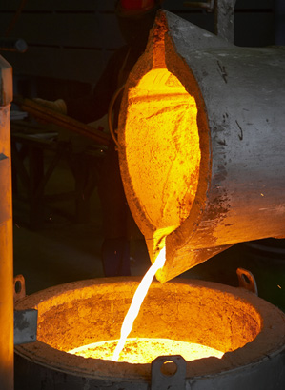
The FoF 2020 Roadmap
The FoF PPP: A cross-technology programme
Development of a new high performance material associated to a new technological Energetic, Flexible, Economical, Versatile and Ecological process to make super strong and lightweight components
Notes:
Components of FoF 2020
The six R&I priority domains – heart of FoF 2020 roadmap

Slide 24

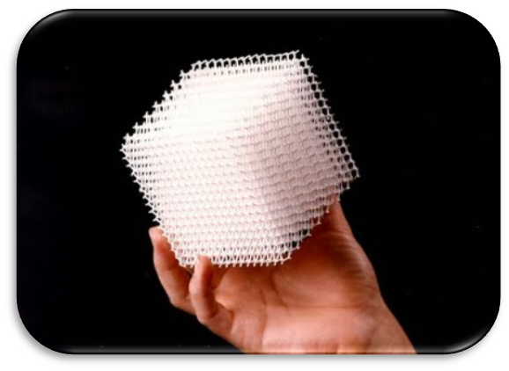
The FoF 2020 Roadmap
The FoF PPP: A cross-technology programme
Additive manufacturing aiming towards zero waste & efficient production of high-tech metal products
4 Pilot-scale Industrial AM factories
Notes:
Components of FoF 2020
The six R&I priority domains – heart of FoF 2020 roadmap

Slide 25
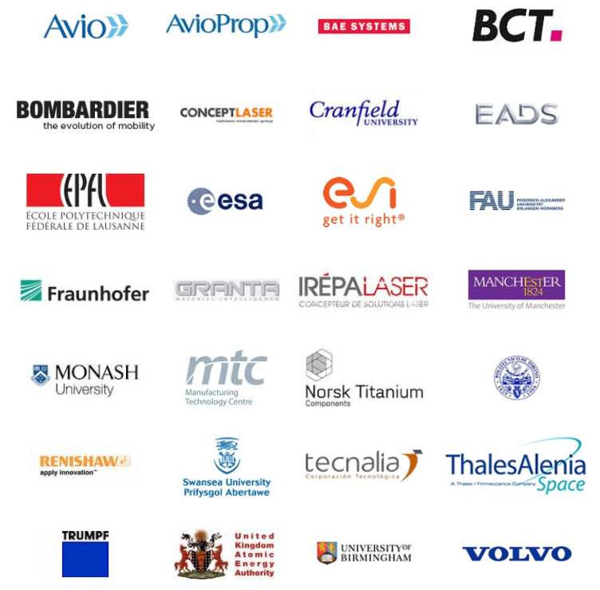
The FoF PPP: A cross-technology programme
rapidly produce large defect-free additively-manufactured (AM) metallic components up to 2 metres in size
ideally with close to zero waste
for use in the following high-tech sectors namely: aeronautics, space, nuclear fusion, automotive and tooling.
Total budget: €18 million
Duration: 54 months
4 Pilot-scale Industrial AM factories
Notes:
Components of FoF 2020
The six R&I priority domains – heart of FoF 2020 roadmap

Slide 26

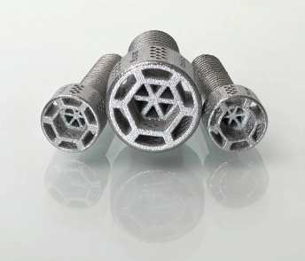
The FoF 2020 Roadmap
The FoF PPP: A cross-technology programme
High performance Production line for Small Series Metal Parts
Demonstration of concept by pilot implementation for serial production of customized high quality meso-parts for electronics and aerospace industries
Total budget: € 3.9 million
Duration: 36 months
Notes:
Components of FoF 2020
The six R&I priority domains – heart of FoF 2020 roadmap

Slide 27


The FoF 2020 Roadmap
The FoF PPP: A cross-technology programme
Pilot-scale hybrid roll to roll/sheet to sheet manufacturing chain for flexible OLEDs
Demonstration of a reliable manufacturing process for OLED lighting foils enabling market introduction within 3 years after the end of the project.
Total budget: € 11 million
Duration: 36 months
Notes:
Components of FoF 2020
The six R&I priority domains – heart of FoF 2020 roadmap

Slide 28

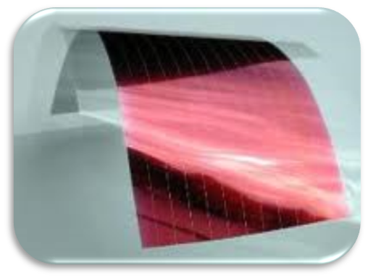
The FoF 2020 Roadmap
The FoF PPP: A cross-technology programme
Electrodes for Large Area, Large Scale Production of Organic Optoelectronic Devices
Demonstrate production of large area organic electronics using high throughput manufacturing technologies based on roll-to-roll (R2R) wet deposition processes.
Exploitation by pathway from laboratory development to pilot production
Total budget: € 14 million
Duration: 36 months
Notes:
Components of FoF 2020
The six R&I priority domains – heart of FoF 2020 roadmap

Slide 29
Take-up of advanced manufacturing technolgies through regional competence centres that support validation-assessment experiments

Slide 30









ICT INNOVATION
FOR MANUFACTURING SMEs
Two types of take-up activities bringing together relevant actors from the use and the supply side, supported by competence centres as appropriate.
  Application experiments will target
    Advanced robot solutions for new manufacturing applications
    Simulation services for engineering and manufacturing SMEs including a cloud-based service infrastructure that provides the needed high performance computing resources
  Assessment experiments will target
    Innovative sensor-based equipment solutions in manufacturing and control
    Innovative laser applications in manufacturing
7 projects
> 150 experiments

Slide 31
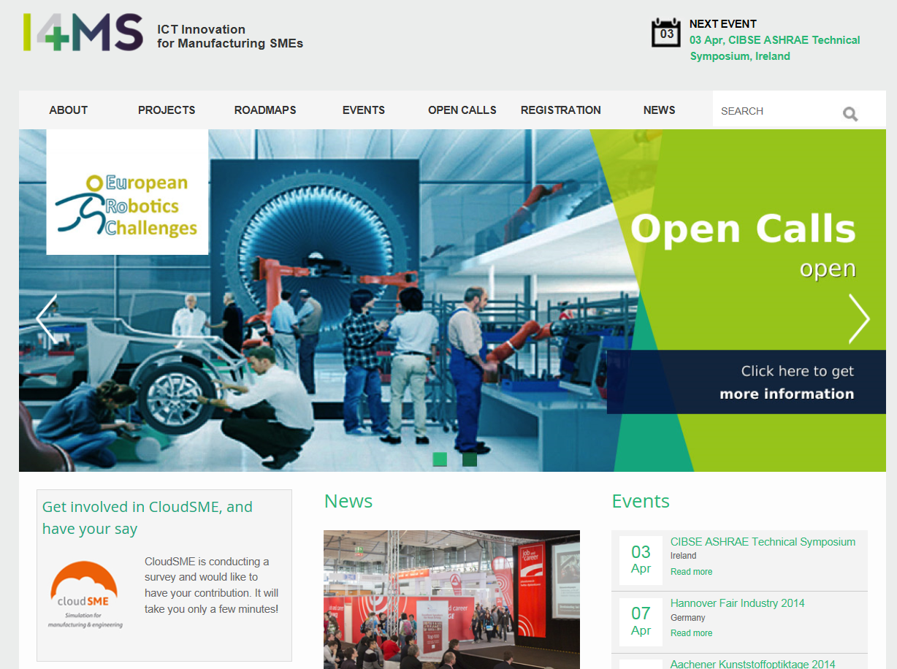

Slide 32


Slide 33
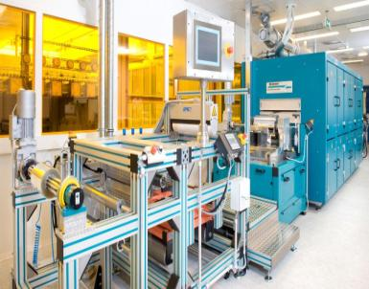
Factories of the Future
After Projects – What Next?
Stronger support for projects in terms of impact generation and synergies across and beyond the programme
Looking beyond the projects
  Technology transfer
  Generating uptake – the road to the market
  Clustering results in take-up activities
©Holst
Factories of the Future is an opportunity:
To make things different from the past
To develop an eco-system that fosters market uptake

Slide 34
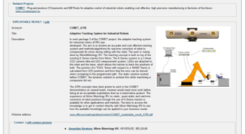
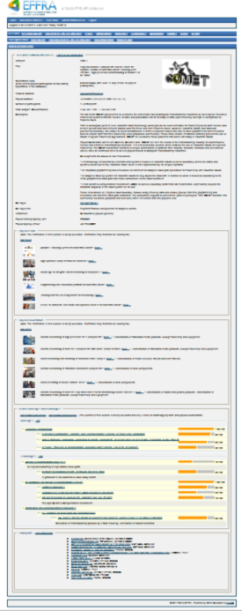

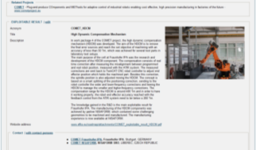
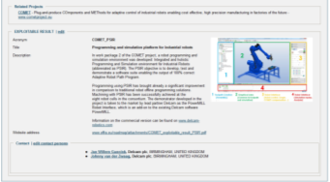
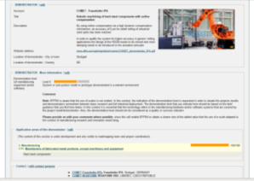
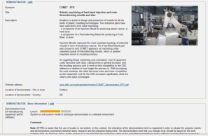
Portfolio management and monitoring
www.effra.eu/portal
General project information
Link to project website
…
Exploitable results
overview
Project demonstrators overview
Addressed challenges and technologies
Project participants

Slide 35
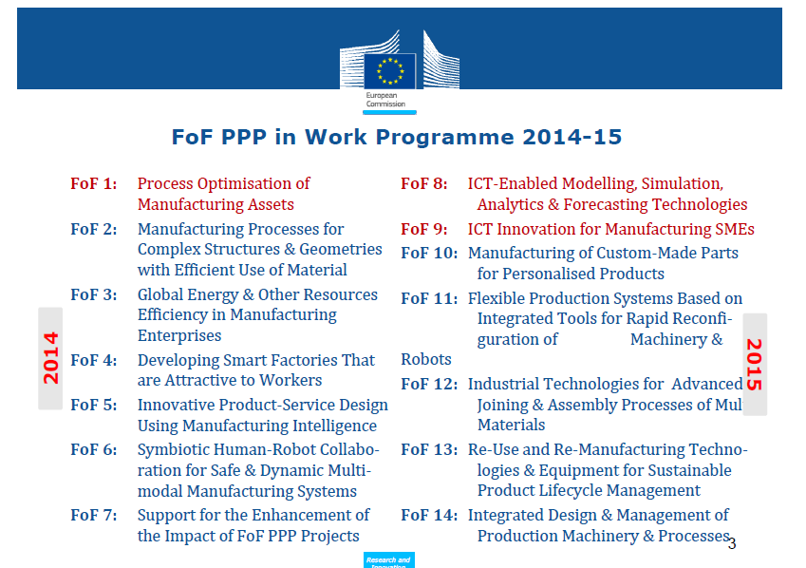

Slide 36
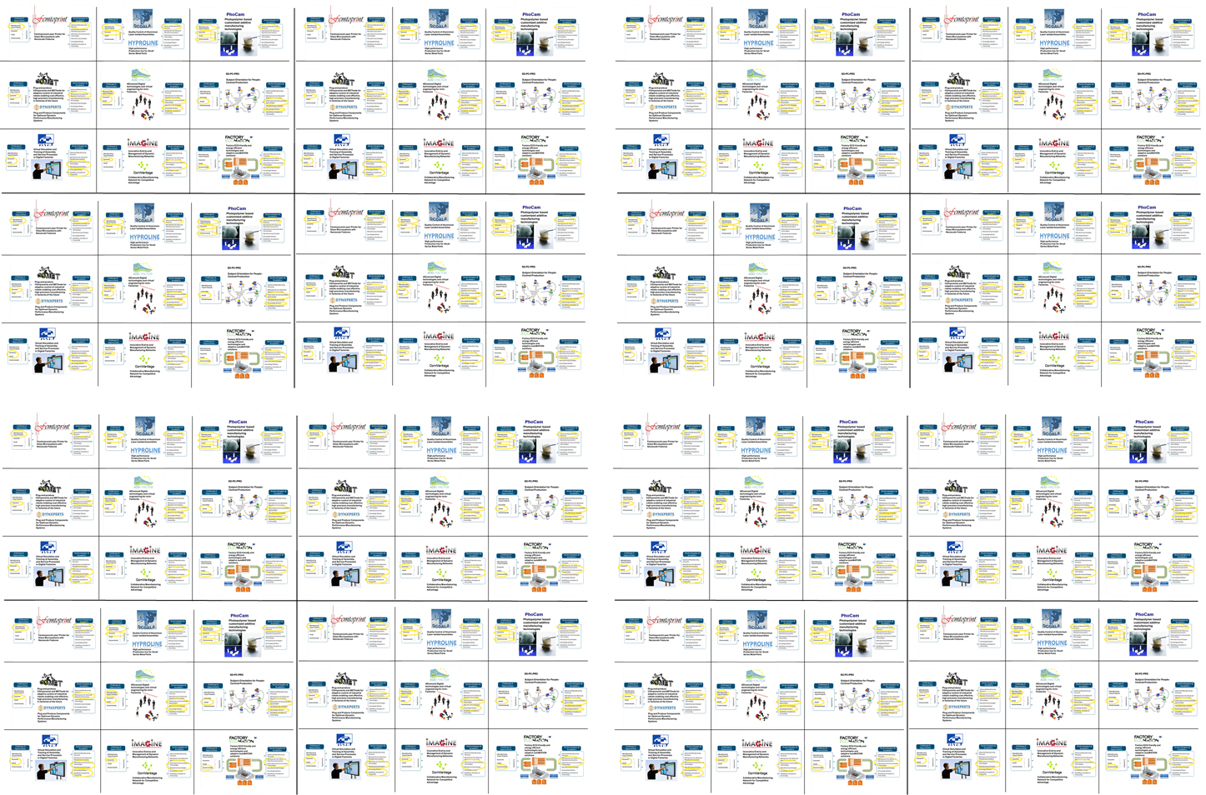





www.effra.eu/portal
Ready for
Thank You
Rikardo Bueno
rikardo.bueno@tecnalia.com
More info: chris.decubber@effra.eu
@EFFRA_Live
EFFRA.EU
EFFRA.Live
EuropeanFactories

